Slide 1


CORONA VIRUS CASE ANALYSIS USING SQL
BY GREESHMA SAJU

Slide 2

CASE OVERVIEW
PROJECT GOAL:
Gain practical experience using SQL for data analysis within a real-world scenario.
Derive meaningful insights about the spread and impact of the COVID-19 pandemic from the dataset.
TASK:
Use SQL to answer 16 specific questions provided in the "Reference File for Corona data."
These questions likely focus on various aspects of the pandemic, such as:
Trends in confirmed cases, deaths, and recoveries over time
Regional differences in the spread of the virus
Correlations between different variables
The impact of various factors on the pandemic

Slide 3







DATASET
The dataset contains information about confirmed cases, deaths, and recovered cases of COVID-19 across different geographic locations (provinces and countries).
Each row represents data for a specific date, location, and includes information like:
PROVINCE
COUNTRY/REGION
LATITUDE/LONGITUDE
DATE
CONFIRMED CASES
DEATH
RECOVERED CASES

Slide 4
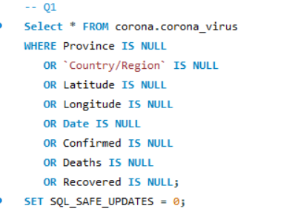

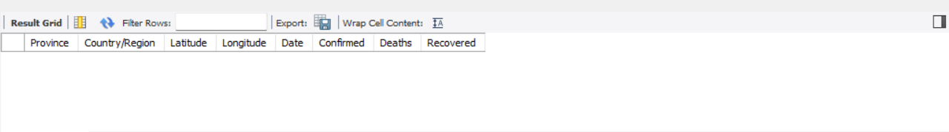
-- Q1. Write a code to check NULL values

Slide 5
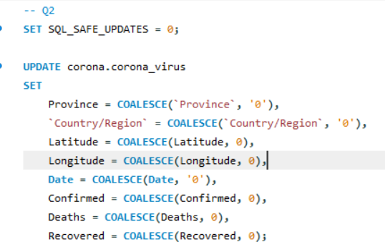
--Q2. If NULL values are present, update them with zeros for all columns.

Slide 6

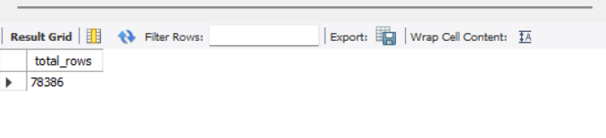
-- Q3. check total number of rows

Slide 7
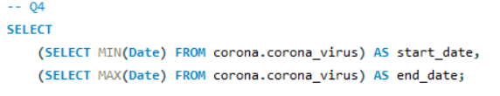
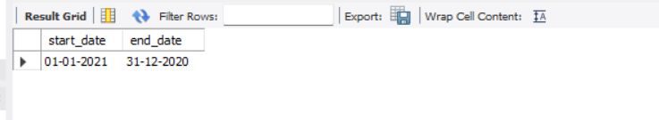
-- Q4. Check what is start_date and end_date

Slide 8
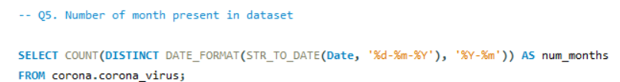
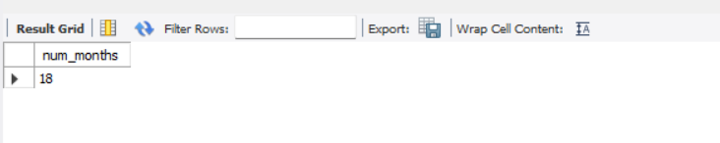
-- Q5. Number of month present in dataset

Slide 9
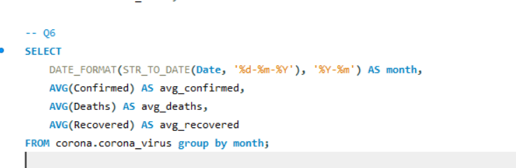
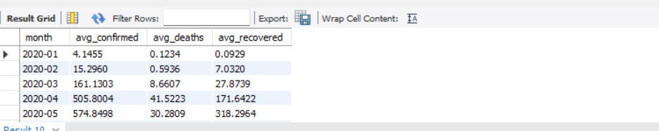
-- Q6. Find monthly average for confirmed, deaths, recovered

Slide 10
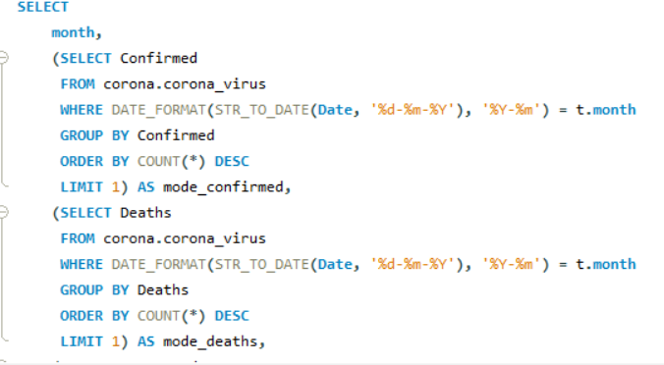
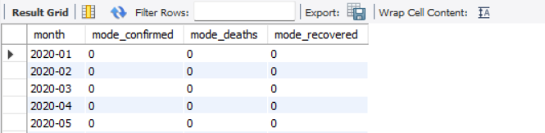
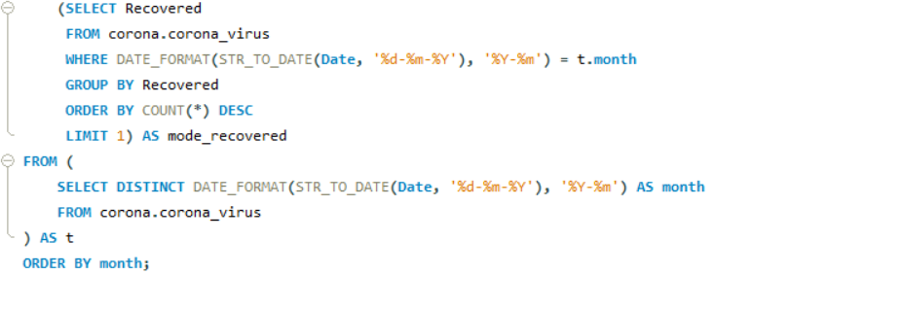
-- Q7. Find most frequent value for confirmed, deaths, recovered each month

Slide 11
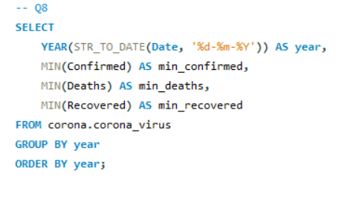
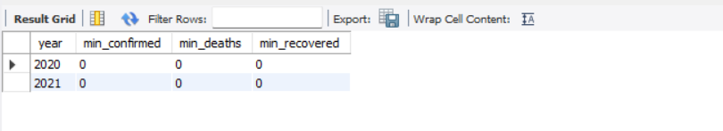
-- Q8. Find minimum values for confirmed, deaths, recovered per year

Slide 12
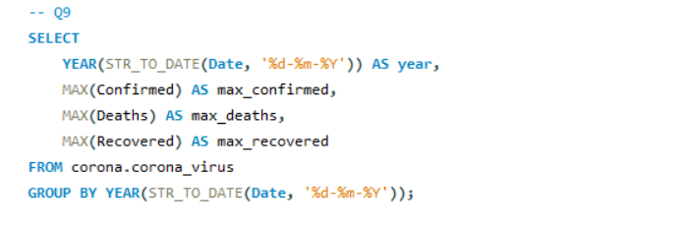
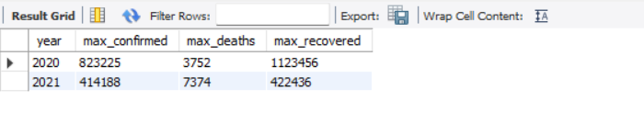
-- Q9. Find maximum values of confirmed, deaths, recovered per year

Slide 13
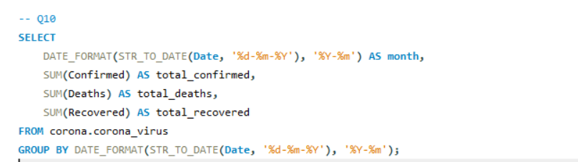
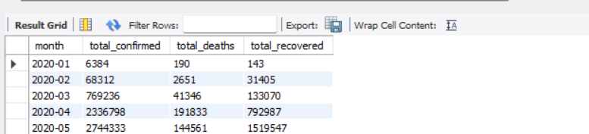
-- Q10. The total number of case of confirmed, deaths, recovered each month

Slide 14
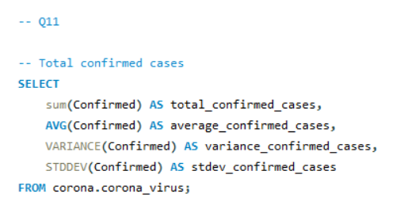
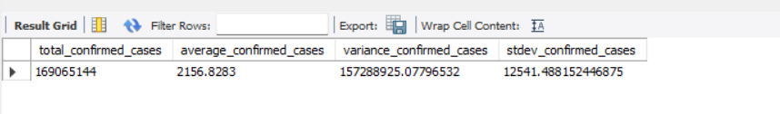
-- Q11. Check how corona virus spread out with respect to confirmed case
-- (Eg.: total confirmed cases, their average, variance & STDEV )

Slide 15
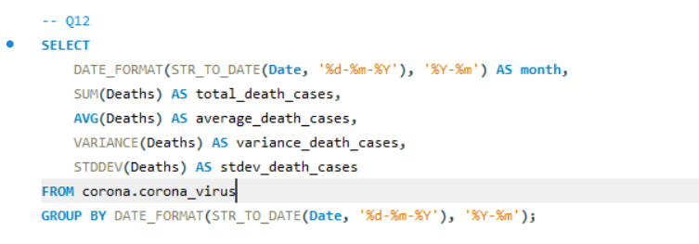
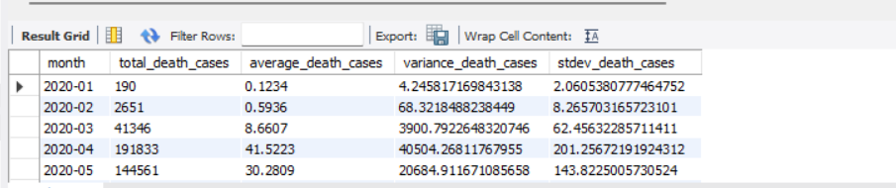
-- Q12. Check how corona virus spread out with respect to death case per month
-- (Eg.: total confirmed cases, their average, variance & STDEV )

Slide 16
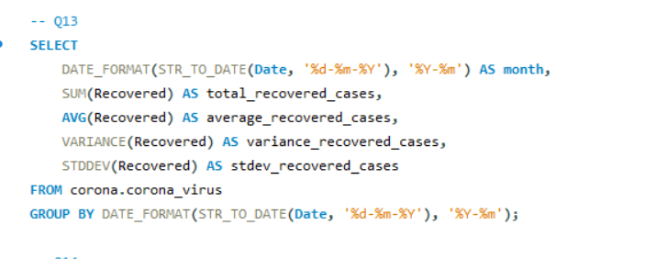
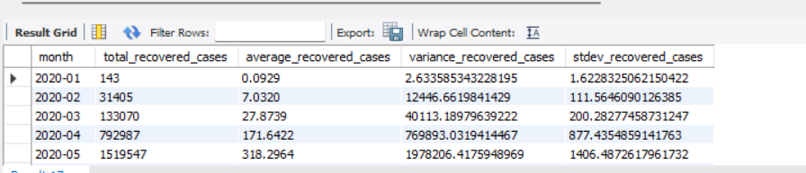
-- Q13. Check how corona virus spread out with respect to recovered case
-- (Eg.: total confirmed cases, their average, variance & STDEV )

Slide 17
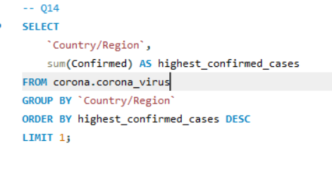
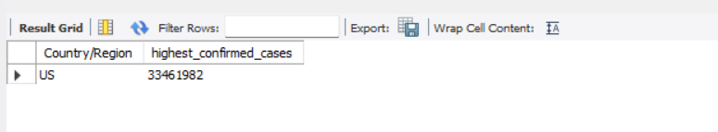
-- Q14. Find Country having highest number of the Confirmed case

Slide 18
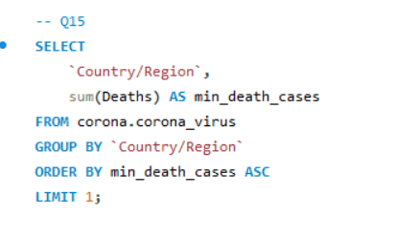
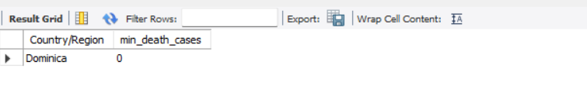
-- Q15. Find Country having lowest number of the death case

Slide 19
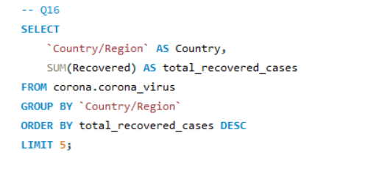
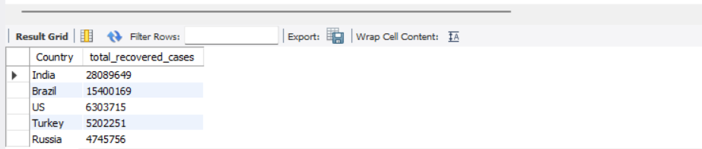
-- Q16. Find top 5 countries having highest recovered case

Slide 20
THANK YOU

